Slide 1
St Andrew’s Rotator PowerPoint Template
This template has been designed for Preachers to ensure compatibility with the rest of the systems used.
When adding or pasting in slides always choose the “Use Destination Theme (H)” option; never the “Keep Source Formatting (K)” option as this changes the underlying template and can cause problems.
When adding a new slide go to ‘Insert’ & then ‘New Slides’ to select the template that you want to use for the new slide.
The absolute minimum text size is 24 point Arial (ideally with Bold and Shadow enabled) in a good contrast for text to be visible from back of church.
The projection system in church in daylight means that the contrast will not be as good as viewed on your computer screen. Also avoid using borders as these can distort.
We use a 1024 x 768 display and any full screen images should be as close to this as possible for clarity.
Slides such as the welcome, hands and title slides are there purely as examples.

Slide 2
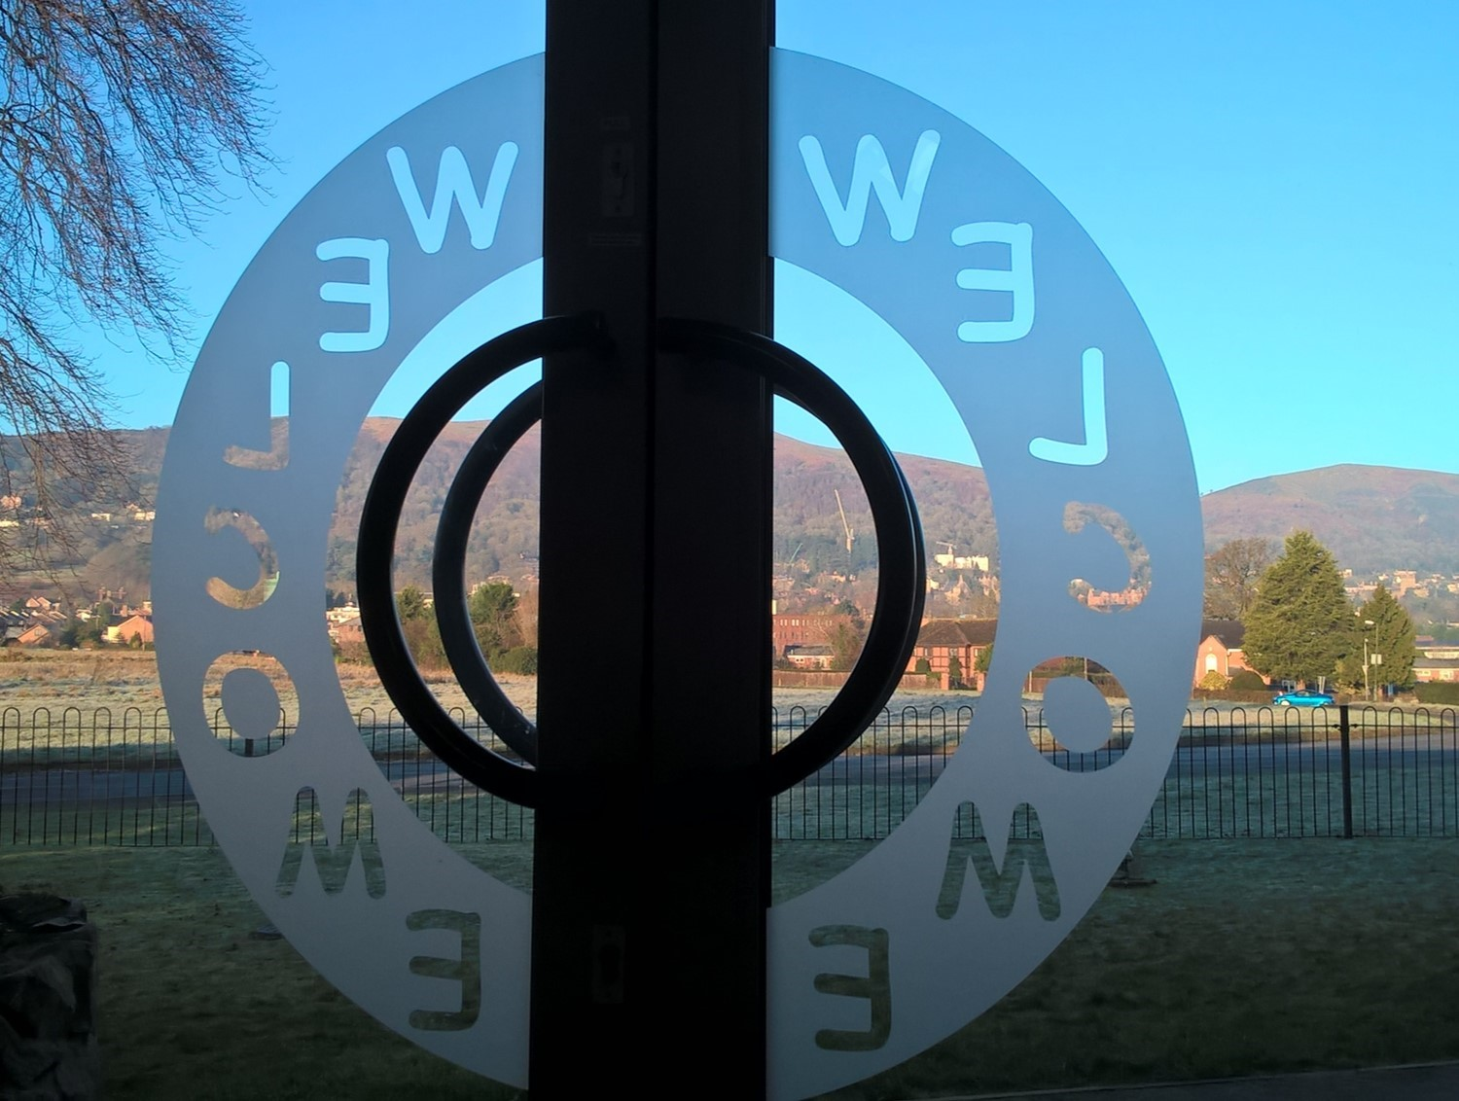

Slide 3
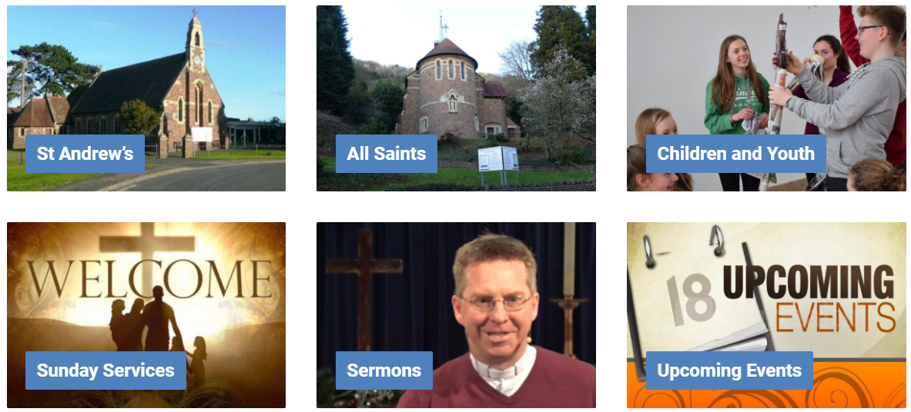
StAndrew’s&AllSaints
Partnering with God in the flourishing of our communities
See our website for full details of what's happening
www.standrewsandallsaints.org

Slide 4
OFFERTORY If you would like to make an offering please place it on the plate at the back of church, near the entrance on the way in (or out).
For tax-efficient giving, tax payers please use a named gift envelope. Thank you.

Slide 6
Experience Easter
Join our Easter Journey
Monday 15th - Thursday 18th April
10am – 5pm
St Andrew’s Church
An opportunity to journey in your own time through the events of the Easter story.
If you would like to host a slot please sign up at the back of Church.

Slide 7
StAndrew’s&AllSaints
Partnering with God in the flourishing of our communities
Follow us on social media:
@standrewsandallsaints
@StAandASmalvern

